Slide 1



BSAI Octopus Stock Complex Update
Lee Cronin-Fine, Benjamin C. Williams and
Kerim Aydin
November, 2023, Presentation to the BSAI Groundfish Plan Team

Slide 2
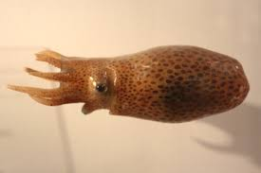
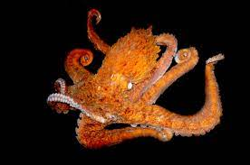
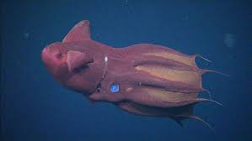
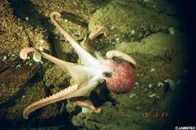
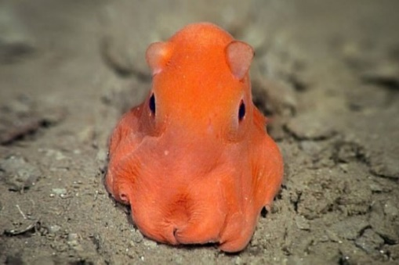
Octopus Species
Enteroctopus dofleini, Sasakiopus salebrosus, Benthoctopus leioderma, Benthoctopus oregonensis, Graneledone boreopacifica, Opisthoteuthis californiana, Japetella diaphana and Vampyroteuthis infernalis
Notes:
There are over 8 species
Enteroctopus dofleini – Giant Octopus most common

Slide 3
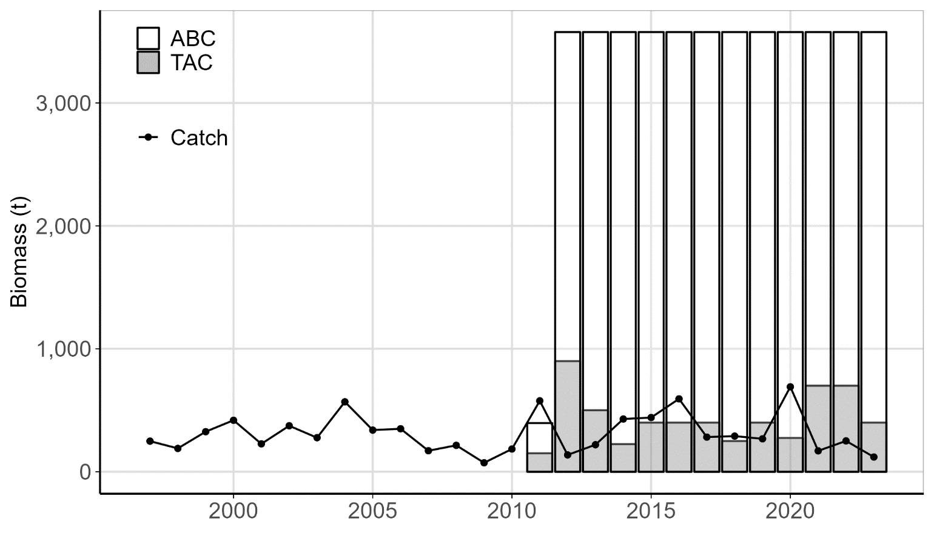
Stock Complex Overview
Tier 6
OFL | 4,769 t
ABC | 3,576 t
Catch* | 120 t
*As of October 17th, 2023
Notes:
2023 values

Slide 4
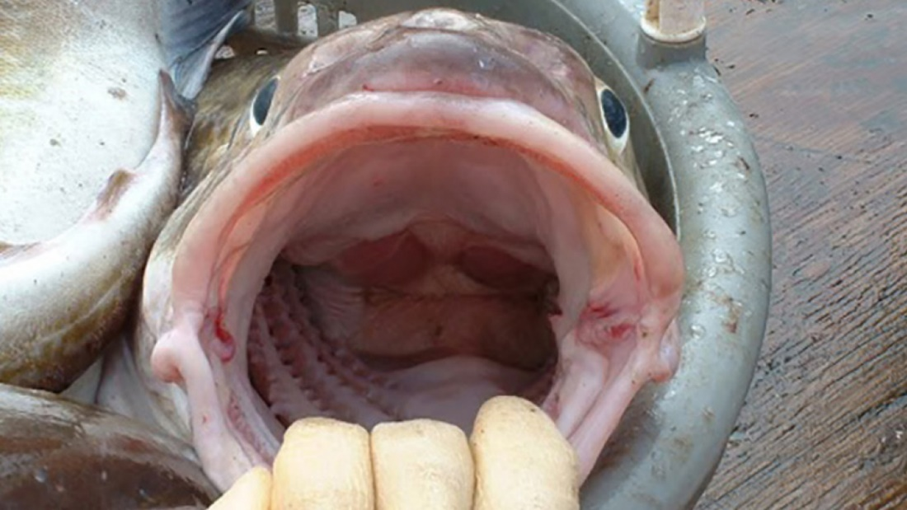
Analytical Approach
Update Assessment
Conservative estimate of total
natural mortality from P.cod
diet data.
Updated Data
Added 13,614 stomachs (52,843 total)

Slide 5
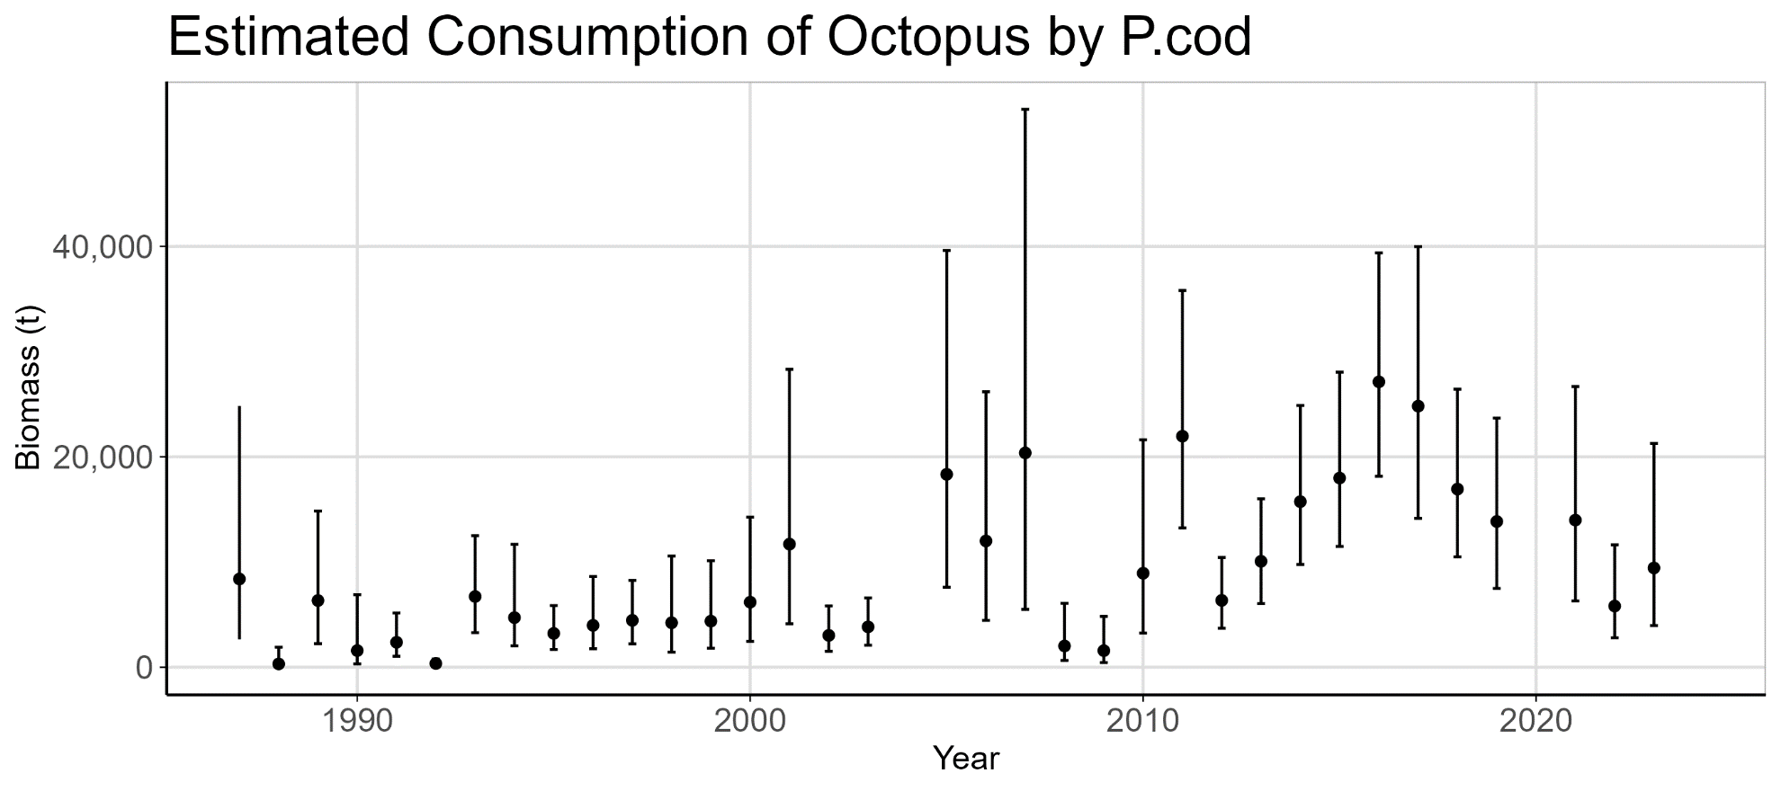
Analytical Approach
Notes:
Geometric mean

Slide 6
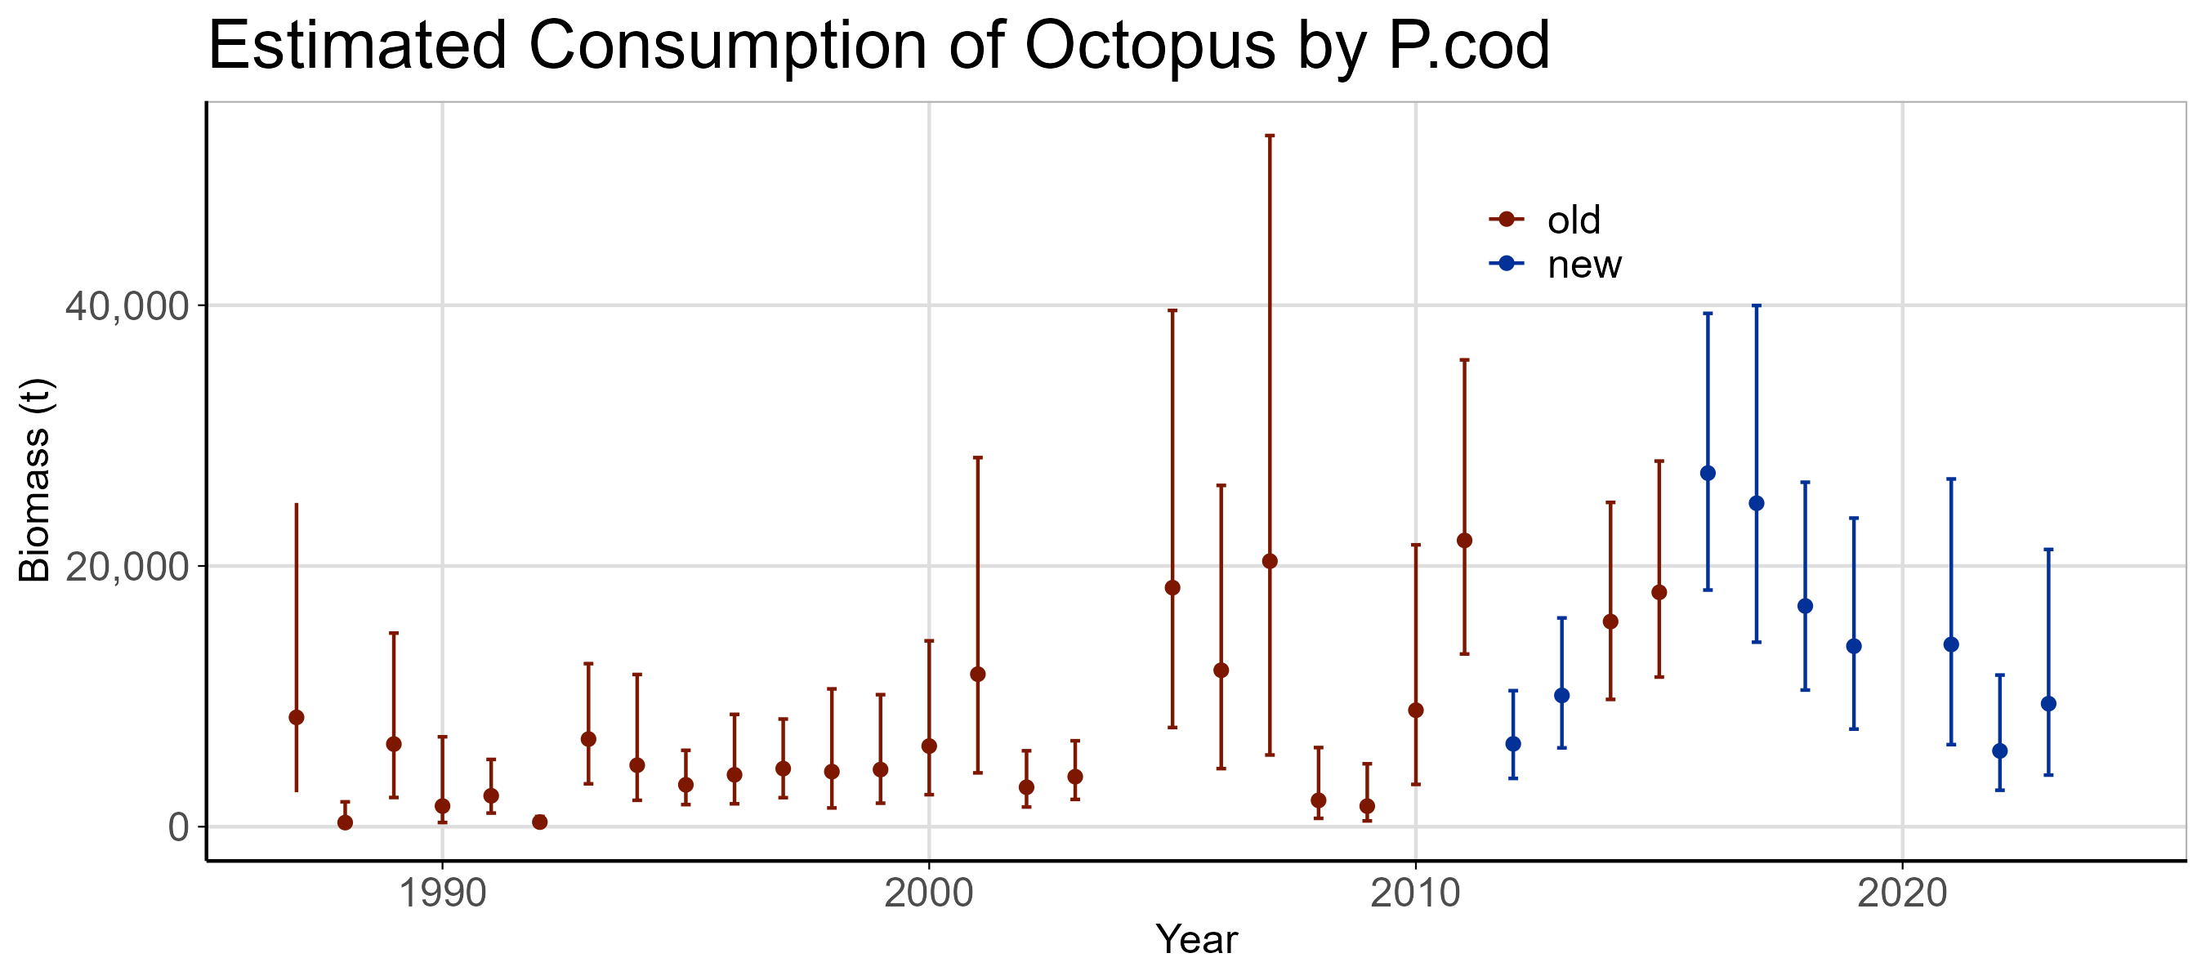
Analytical Approach

Slide 7
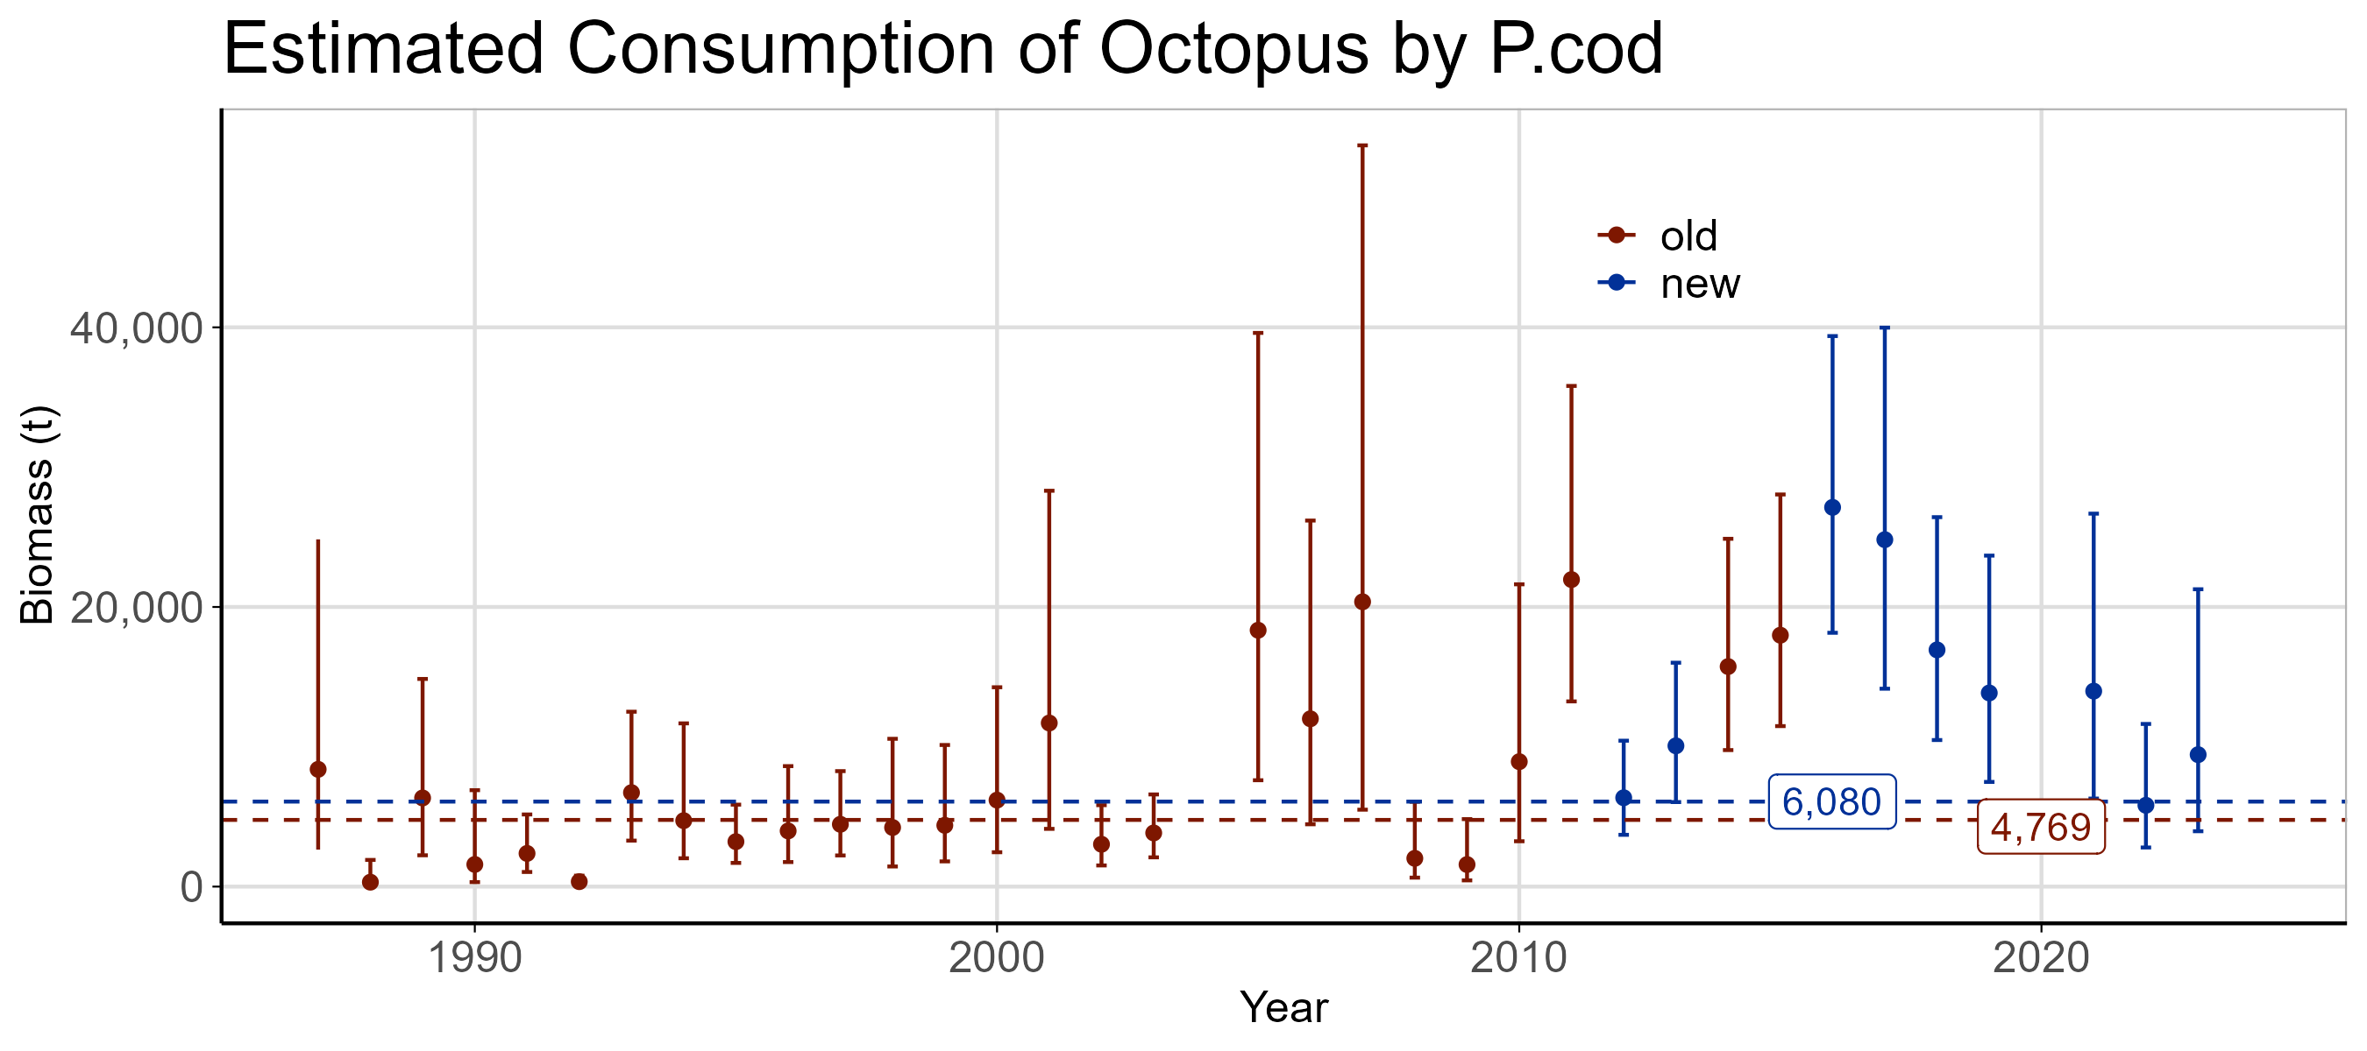
Analytical Approach
Notes:
Say this is a point estimate and why we shouldn’t update each year

Slide 8
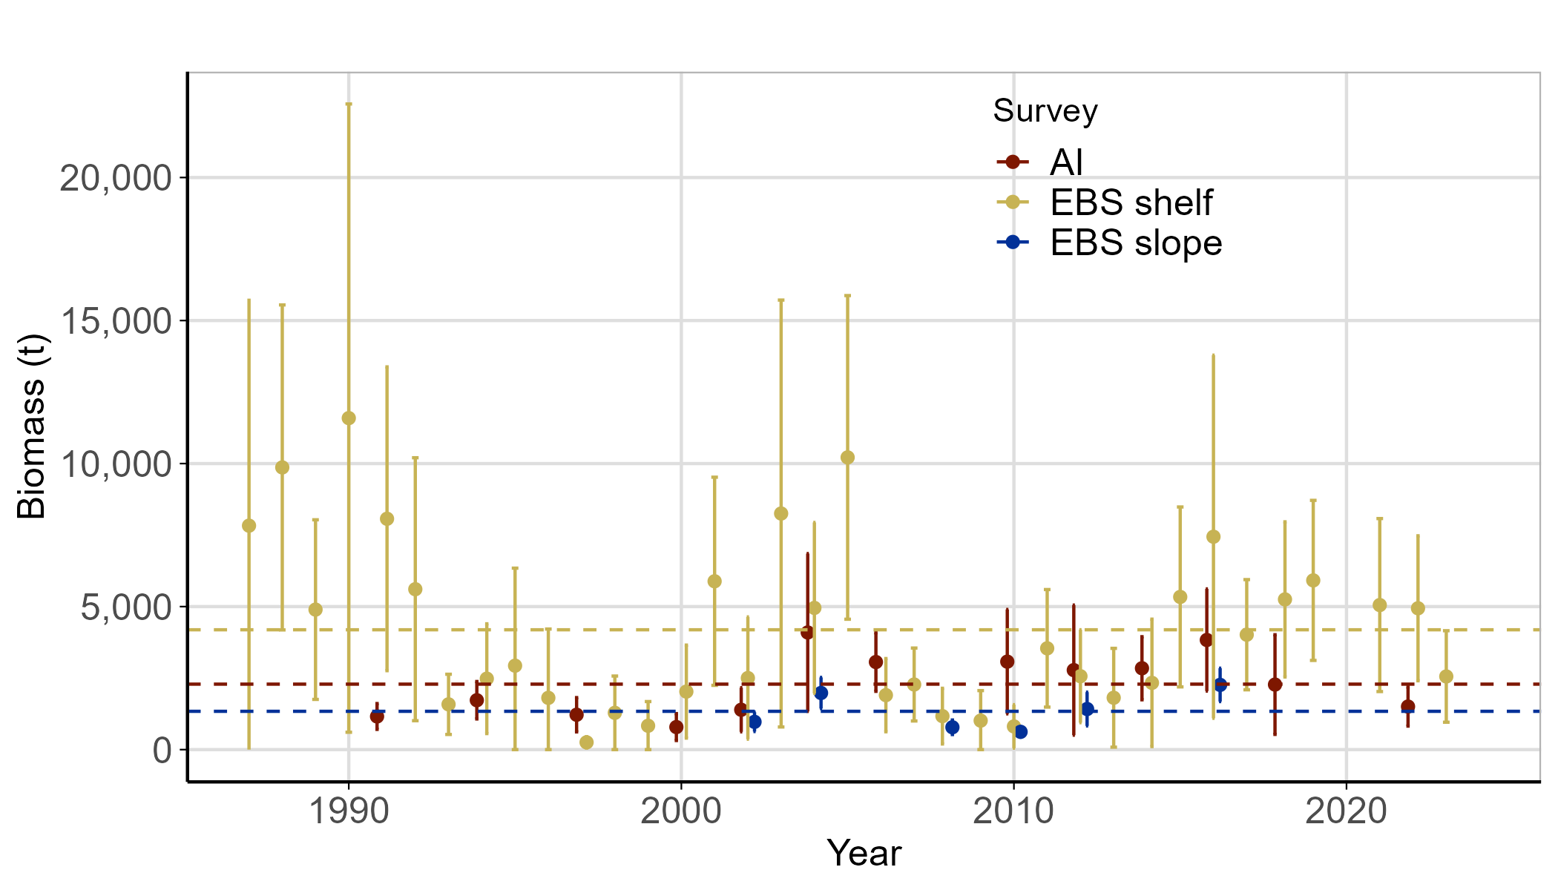
Surveys

Slide 9
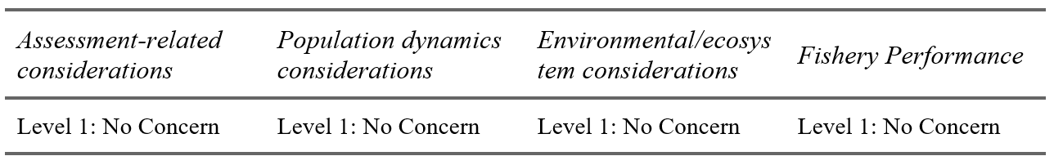
Risk Table Summary

Slide 10
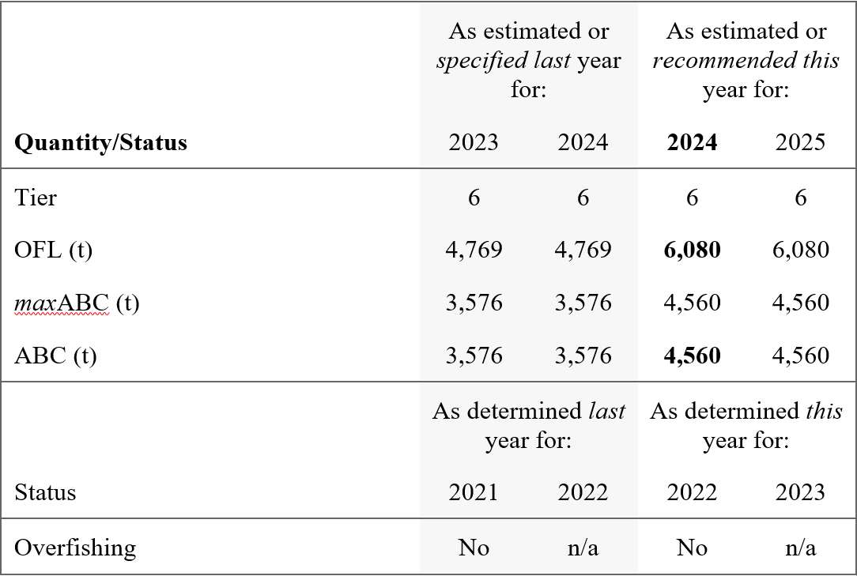
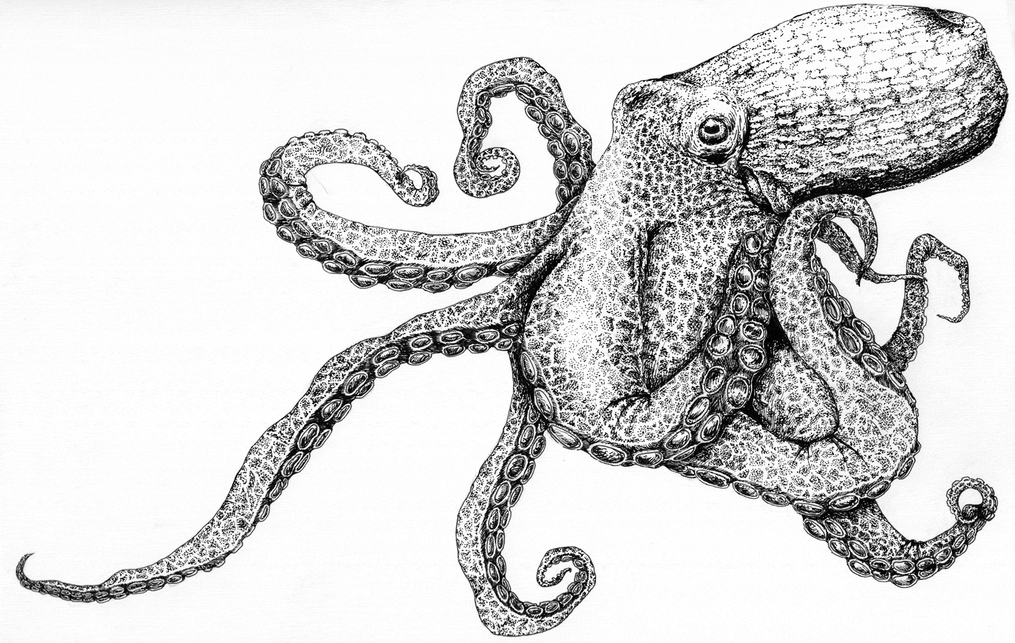
Harvest Recommendations
OFL = Total Natural Mortality
ABC = 0.75*OFL

Slide 11
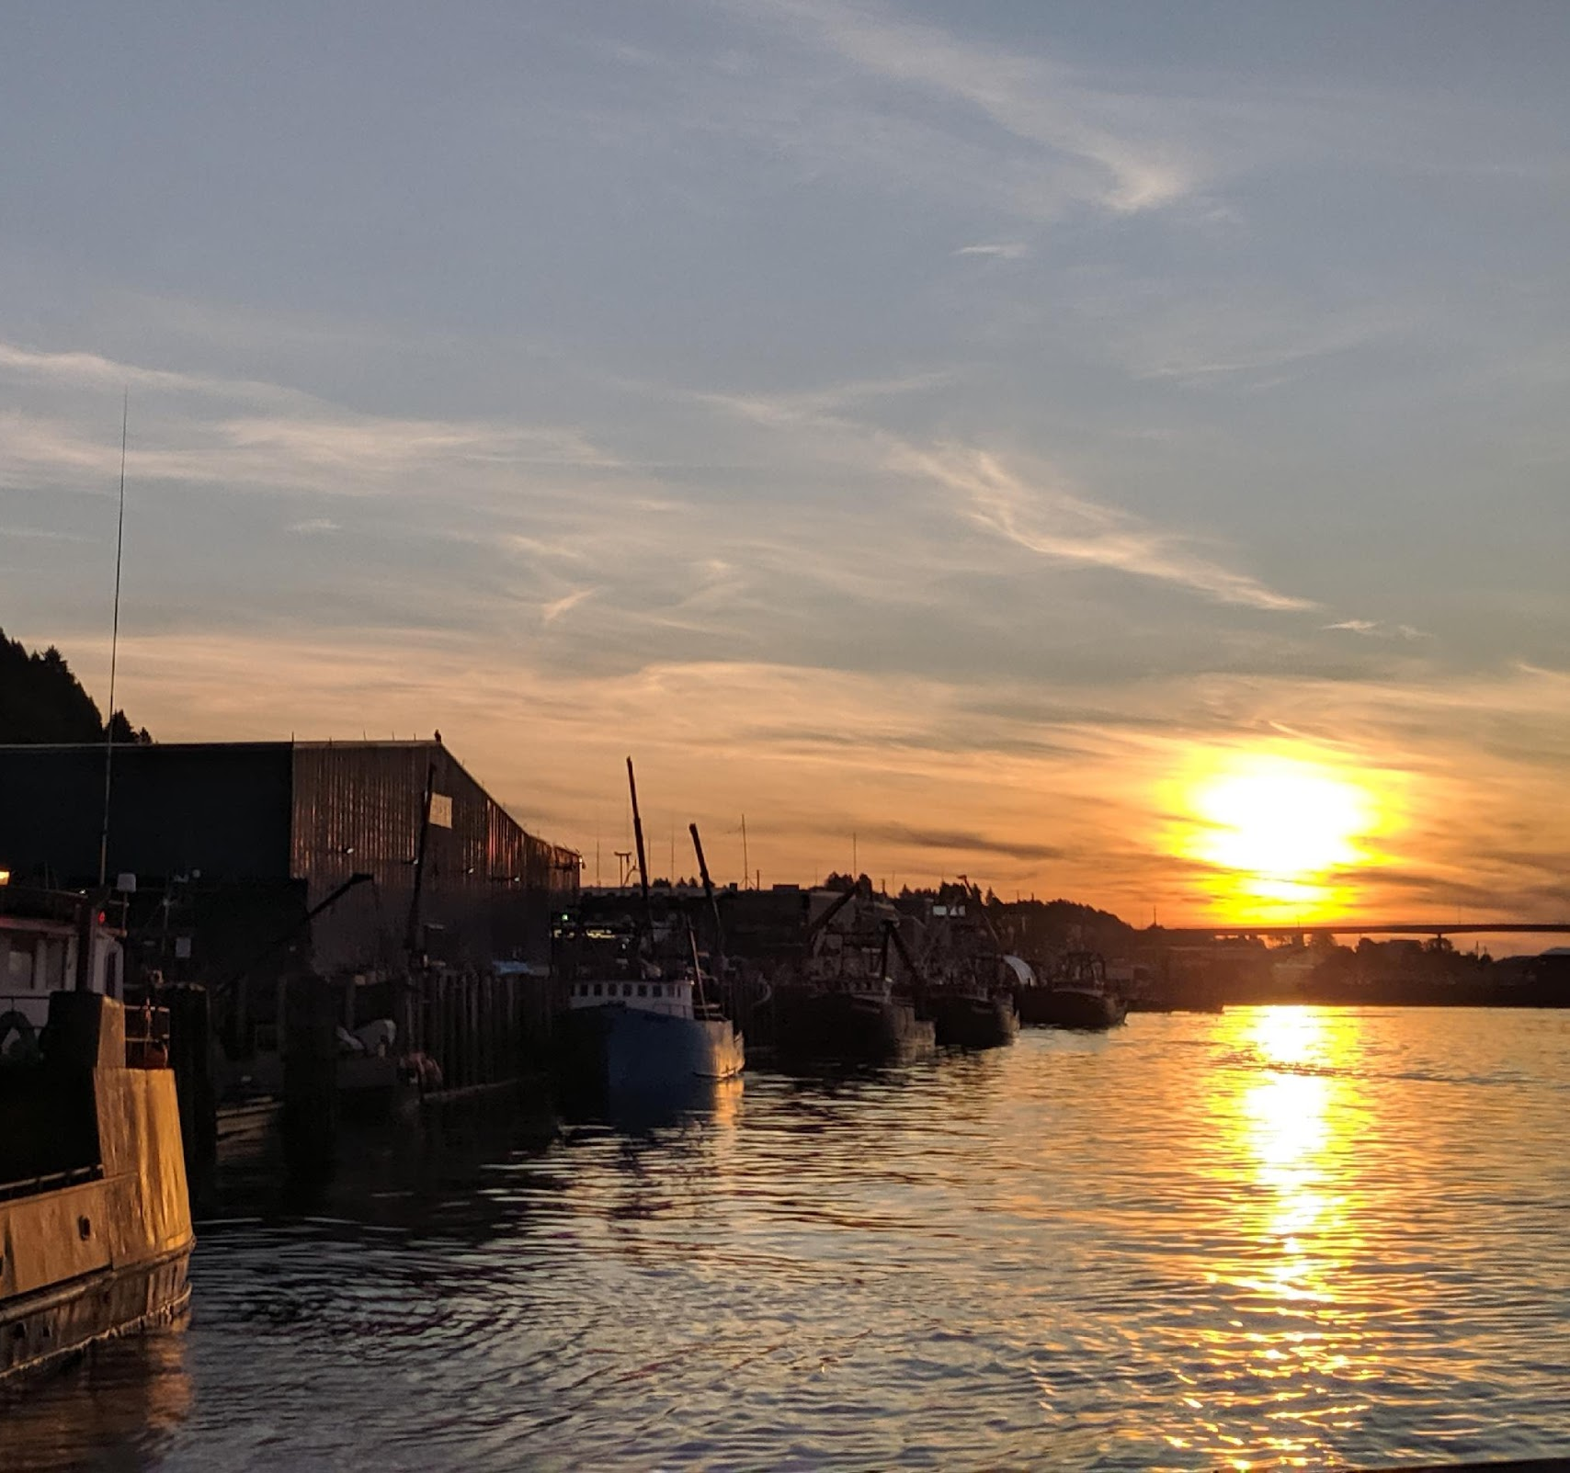
QUESTIONS?
Contact:
LEE.CRONIN-FINE@NOAA.GOV

